Slide 1

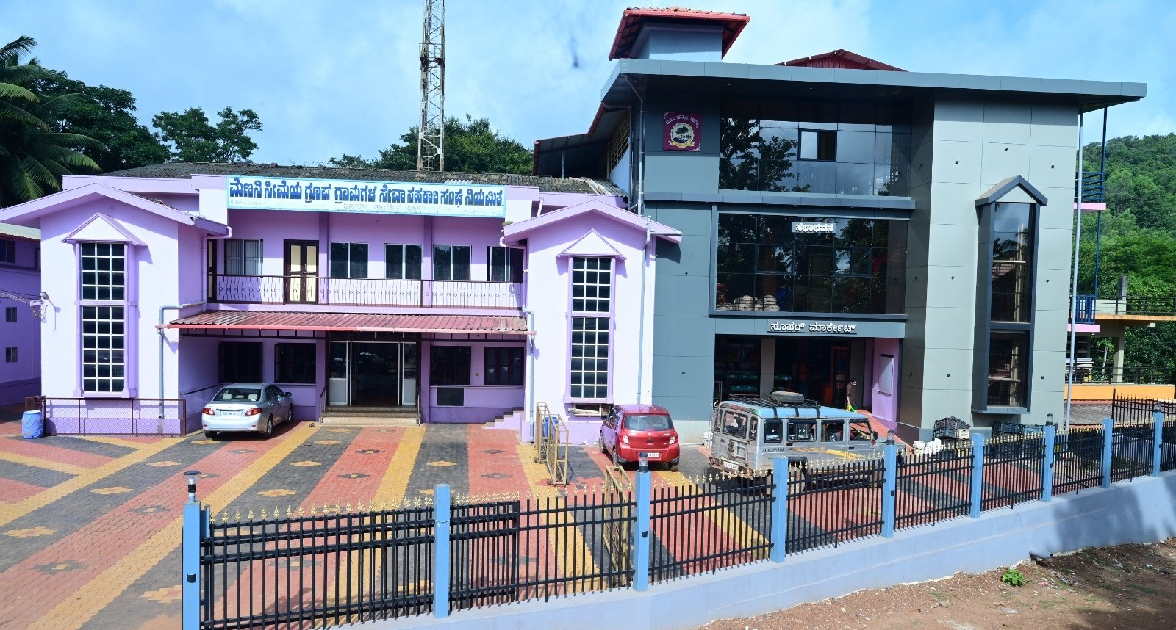
JSS Shri Manjunatheshwara Institute of UG & PG Studies Vidyagiri, Dharwad. CO-OPERATIVE SOCIETY MANAGEMENT SYSTEM
Under the guidance of By:
Prof. Venus Mishra K. N. Keerti [U02BF22S0001]

Slide 2

CONTENTS
INTRODUCTION
OBJECTIVES
EXISTING SYSTEM AND PROPOSED SYSTEM
INPUT AND OUTPUT
MODULES
TOOLS AND PLATFORMS
LIMITATIONS AND SCOPE
CONCLUSION

Slide 3

INTRODUCTION
A Cooperative Society Management System (CSMS) is a software that helps cooperative societies manage daily operations like member records, share transactions, and financial activities. It replaces manual work with a digital platform, making the system more efficient, accurate, and transparent.
It supports better decision-making with real-time data access. The system also improves service delivery and communication with members.

Slide 4

OBJECTIVES
Automate Society Operations
Replace manual processes with a digital system
Simplify tasks like member management and transactions
Improve Member Satisfaction
Provide faster and more accurate services
Enable easy access to account and transaction details
Enhance Financial Management
Ensure accurate record-keeping and reporting
Support better decision-making with real-time analytics

Slide 5

EXISTING SYSTEM
Work is done manually or in Excel
Member and product records are hard to manage
Transactions are calculated by hand
Data is not organized in one place
PROPOSED SYSTEM
Centralized online management of cooperative operations
Digital storage and access of member and product data
Automatic calculation and processing of deposists & withdrawals
Fast information retrieval for users and admins

Slide 6

INPUT
Admin details
Username, password, role
Member details
Personal info, employment status, member ID, account info
Deposits and withdrawal
Transaction date, amount, account number, transaction type
Balance request
Account number, member ID
Transaction extract request
Account number, transaction
Product details
Product ID, product name, description, price, quantity in stock

Slide 7

OUTPUT
Admin details
Admin dashboard, acess to manage member data
Member records
Members profile, account information, transaction history
Deposits & withdrawal confirmation
Trasaction confirmation, updated account balance, transaction receipt
Balance request response
Current account balance, account statement
Product details output
Product catalog with name, price, availability status, and description

Slide 8

MODULES
Admin module
Member details
Product details
Transaction records
Generate transaction receipts
Accountholder (customer) module
Profile information
Account transactions
Balance inquiry
Transaction history
Available products

Slide 9
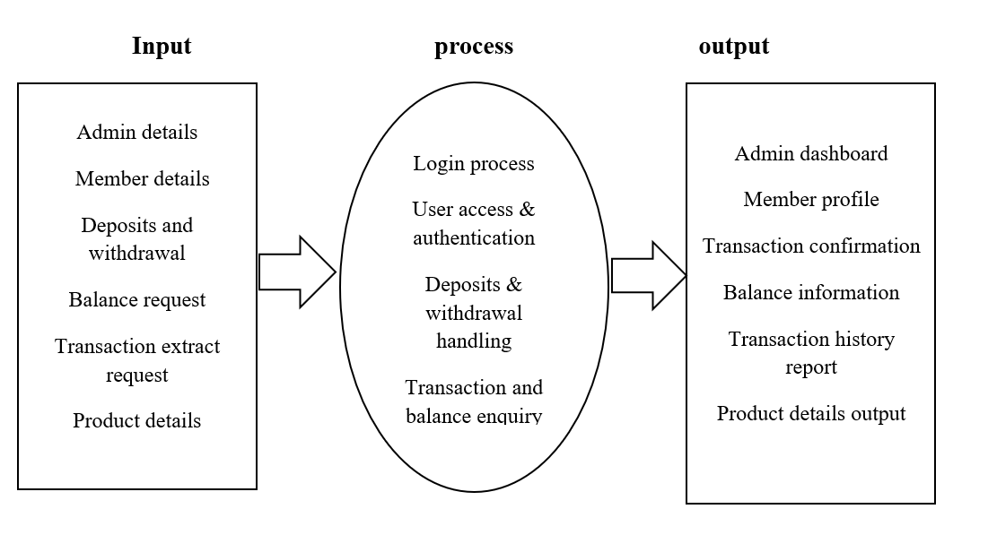
PROCESS LOGIC DIAGRAM

Slide 10

TOOLS AND PLATFORMS
Frontend Development (User Interface)
Languages: HTML, CSS, JavaScript
Backend Development (Server & Business Logic)
Languages: PHP
Database Management System (Storage & Retrieval)
MySQL
Operating system
Windows XP or above
Hardware requirements
Dual core processor(e.g.,Intel core i5 &above , AMD ryzen3 &above)
RAM(memory) : 4GB or more
Hard disk(storage) :250GB

Slide 11
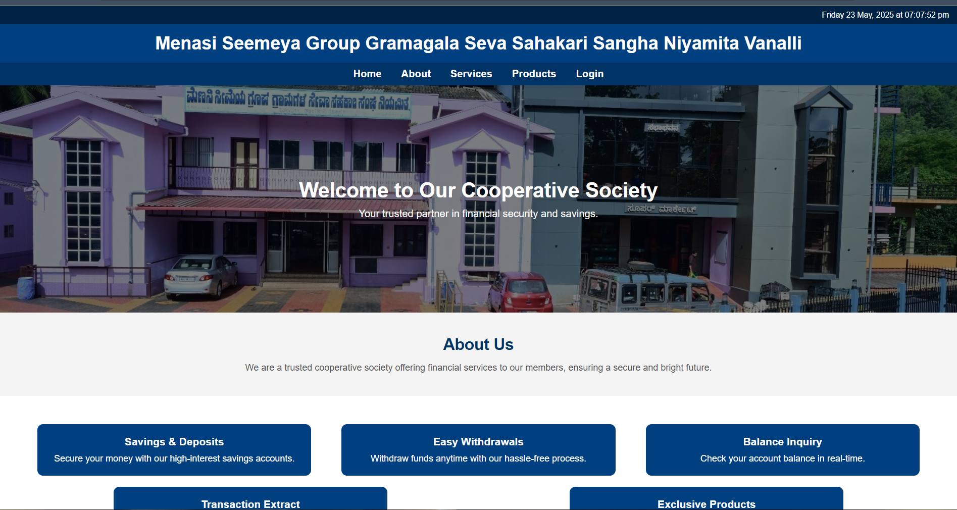
SAMPLE OUTPUT/FORMS/SCREENSHOTS
Home page

Slide 12
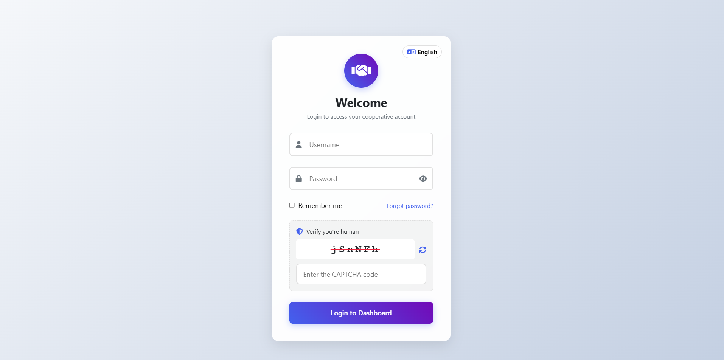
Login page

Slide 13
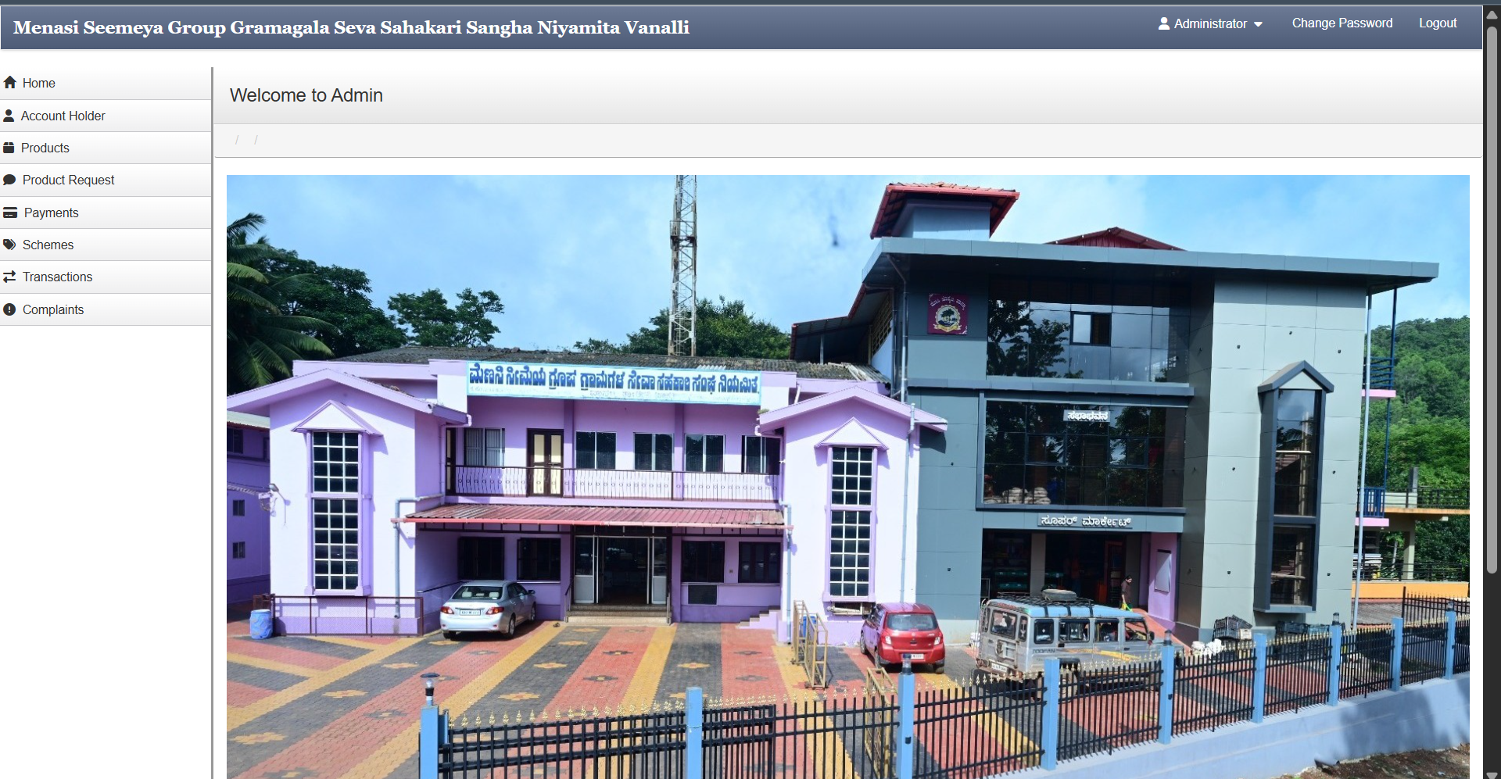
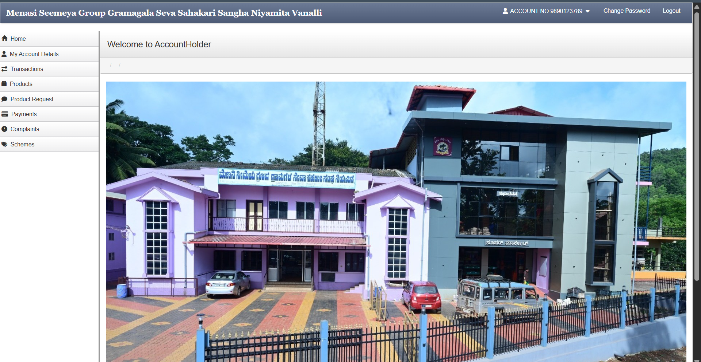
Admin dashboard
Accountholder(customer) dashboard

Slide 14

LIMITATIONS
Scalability issues : The system may slow down as the number of users and transactions increases.
Security risk : There is a risk of unauthorized access due to limited security measures.
No multi-branch support : The system cannot manage multiple branches simultaneously.

Slide 15

SCOPE
Reduces manual work
Online member access
Automated updates (WhatsApp, SMS, email)
Regular data backups
Online payment option possible

Slide 16

CONCLUSION
Co-operative society management system (CSMS) efficiently automates cooperative society operations, reducing paperwork and human error.
It offers a centralized, secure, and user-friendly platform using PHP and MySQL for cost-effective management.
The project provides a solid base for future enhancements like multi-branch support and expanded member self-service features.

Slide 17


